Slide 1
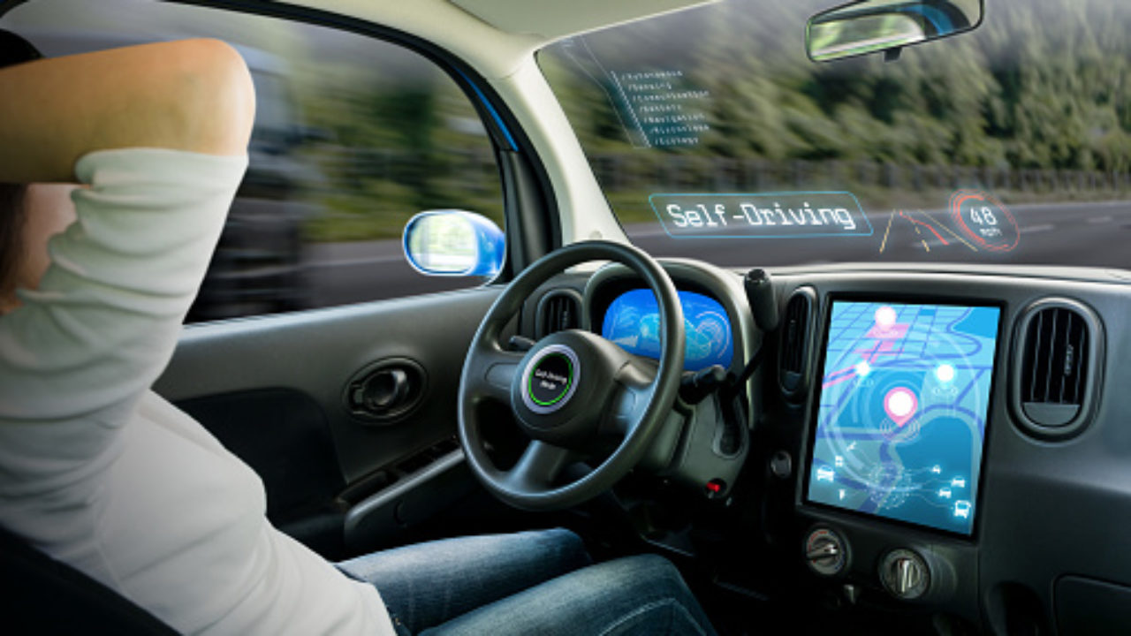
IMAGE SEGMENTATION FOR AUTONOMOUS CARS
Presented by:- Tushaar Sharma

Slide 2
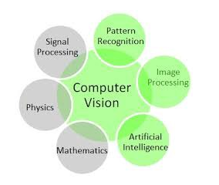
Computer vision is an interdisciplinary scientific field that deals with how computers can be made to gain high-level understanding from digital images or videos.
One specific task in computer vision is called semantic segmentation and one of it’s important applications are the self driving cars .

Slide 3
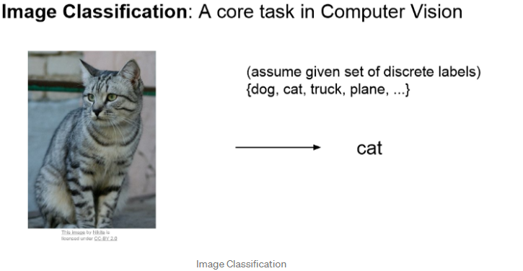
Image Classification

Slide 4
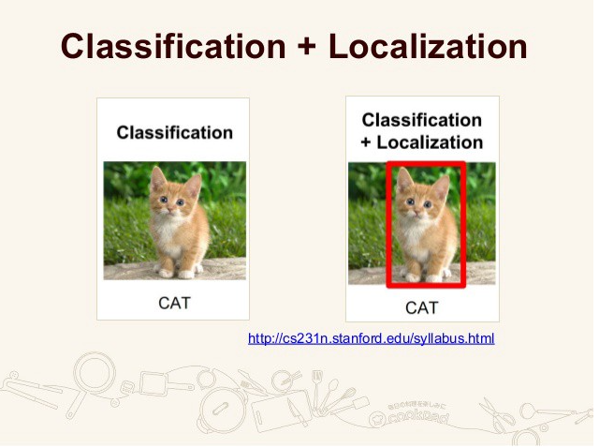
Classification with Localization

Slide 5
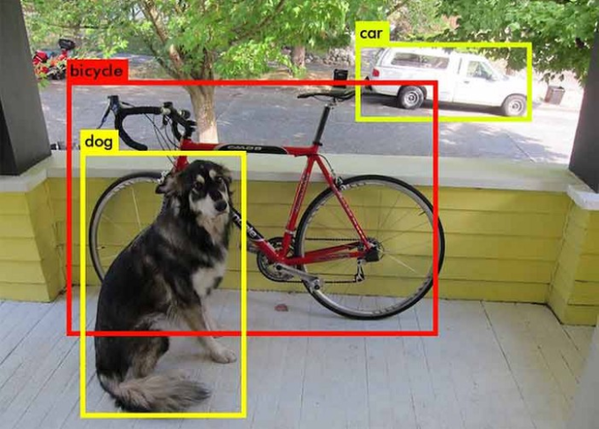
Object Detection

Slide 6
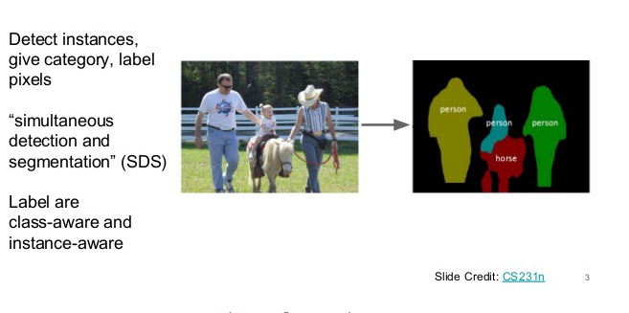
Instance Segmentation

Slide 7
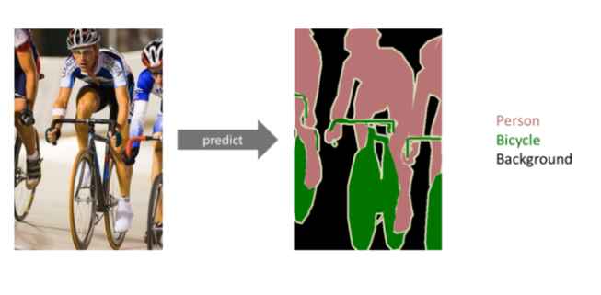
Image Segmentation
Notes:
The goal of semantic image segmentation is to label each pixel of an image with a corresponding class of what is being represented. Because we’re predicting for every pixel in the image, this task is commonly referred to as dense prediction.
Note that unlike the previous tasks, the expected output in semantic segmentation are not just labels and bounding box parameters. The output itself is a high resolution image (typically of the same size as input image) in which each pixel is classified to a particular class. Thus it is a pixel level image classification.

Slide 8
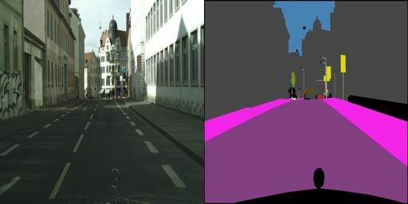
DATASET
The dataset consisted of still images from the original videos, and the semantic segmentation labels shown alongside the original image.
Each image file was of 256x512 pixels, and each file is a composite with the original photo on the left half of the image, alongside the labelled image (output of semantic segmentation) on the right half.

Slide 9
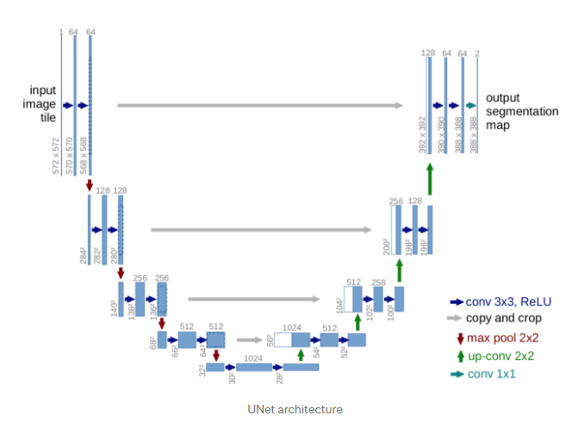
U-NET algorithm to train the dataset.
U-Net is a convolutional neural network that was developed for biomedical image segmentation at the Computer Science Department of the University of Freiburg, Germany.
It can accept images of any size as it an end-to-end fully convolutional network (FCN).
First path is the contraction path (also called as the encoder) which is used to capture the context in the image.
The second path is the symmetric expanding path (also called as the decoder) which is used to enable precise localization using transposed convolutions.

Slide 10
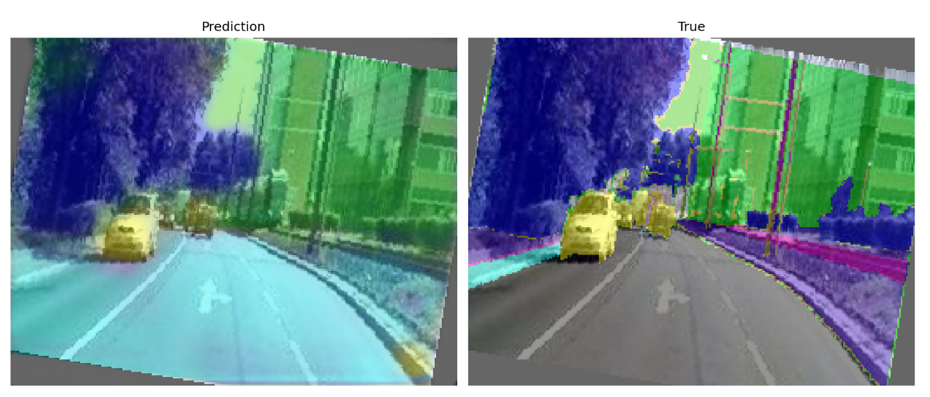
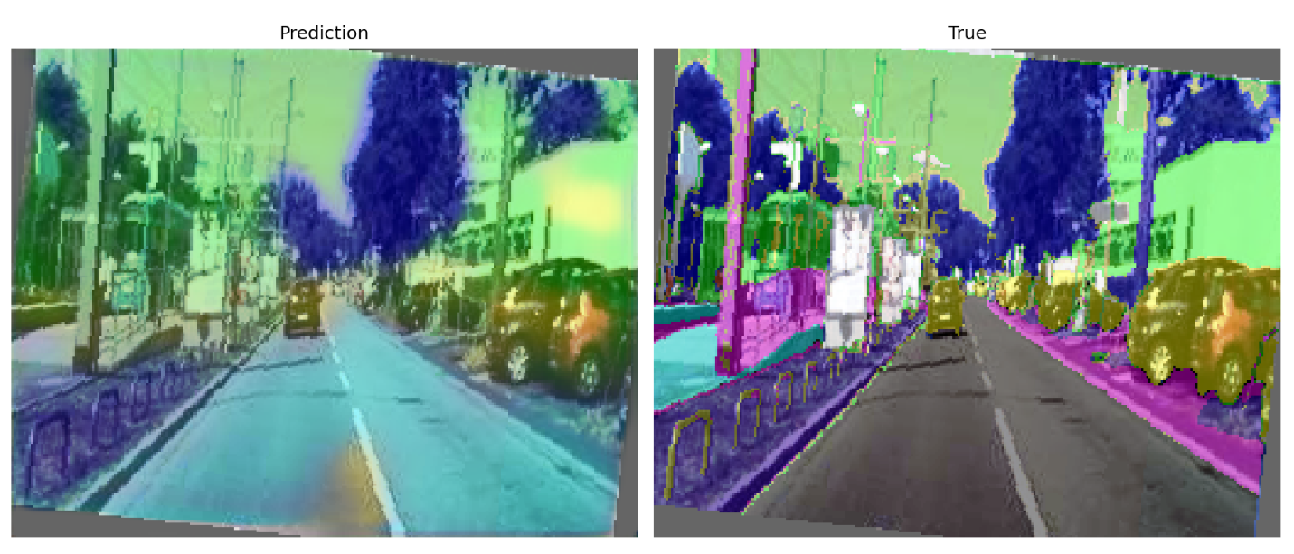
Results after training the algorithm for 35 cycles
EPOCH 35 results

Slide 11
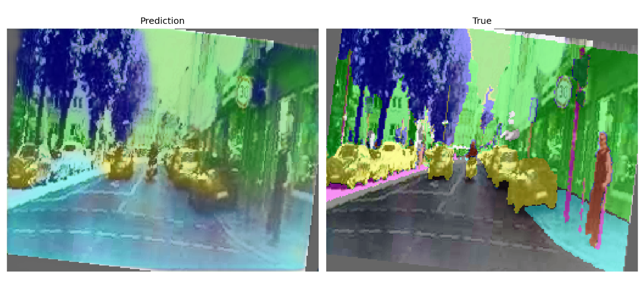
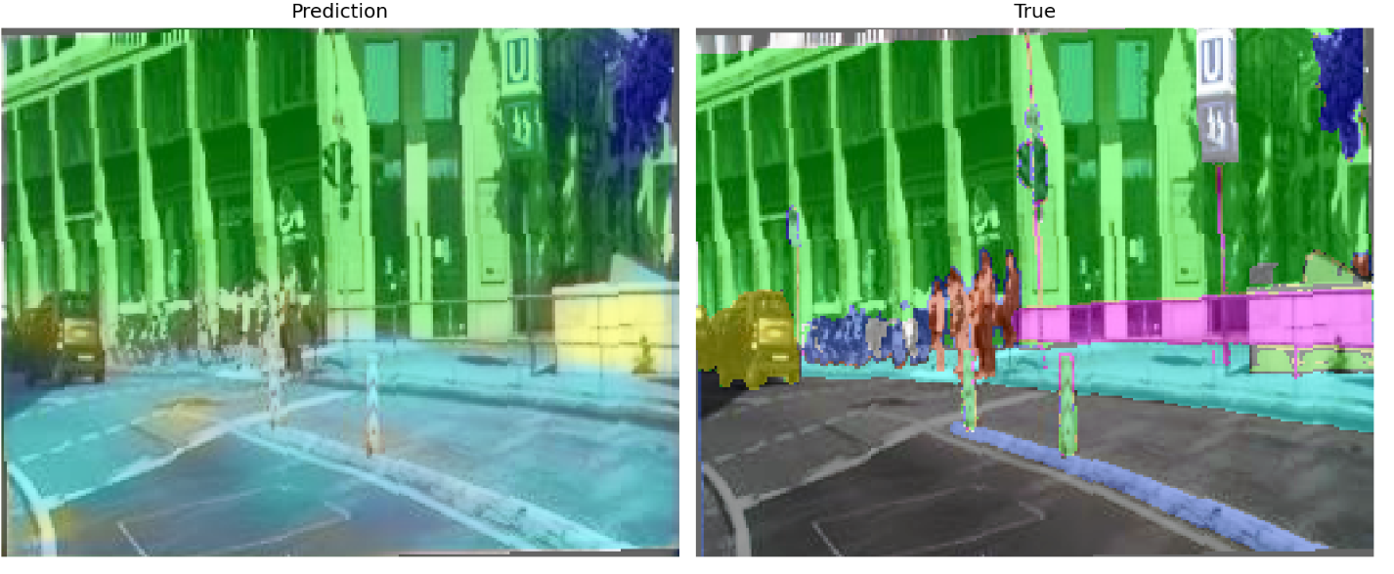
EPOCH 75 results

Slide 12
Conclusion
Accuracy of the model will continue to rise as we to train the model with more cycles and feed in more data to achieve optimum results.

Slide 13
Sources
https://towardsdatascience.com/color-identification-in-images-machine-learning-application-b26e770c4c71
https://towardsdatascience.com/image-segmentation-using-pythons-scikit-image-module-533a61ecc980
https://www.geeksforgeeks.org/extract-dominant-colors-of-an-image-using-python/
https://towardsdatascience.com/unet-line-by-line-explanation-9b191c76baf5
https://medium.com/coinmonks/learn-how-to-train-u-net-on-your-dataset-8e3f89fbd623
https://developers.arcgis.com/python/guide/how-unet-works/

Slide 14
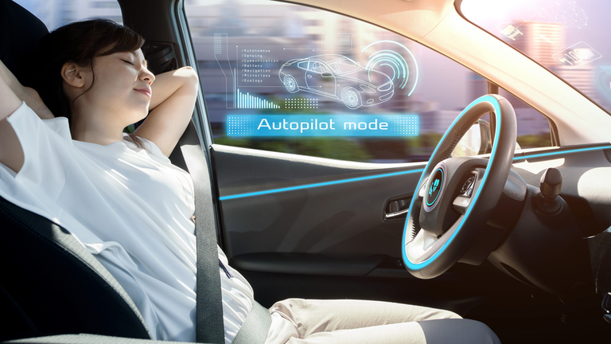
Thank you for your time!
Happy Driving!

